Slide 1
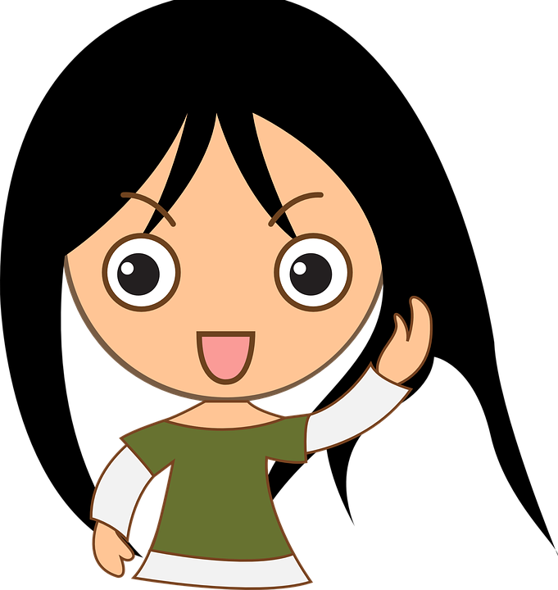
All About Me
Emotions
Let’s learn about Health!

Slide 2


Emotions

Slide 3
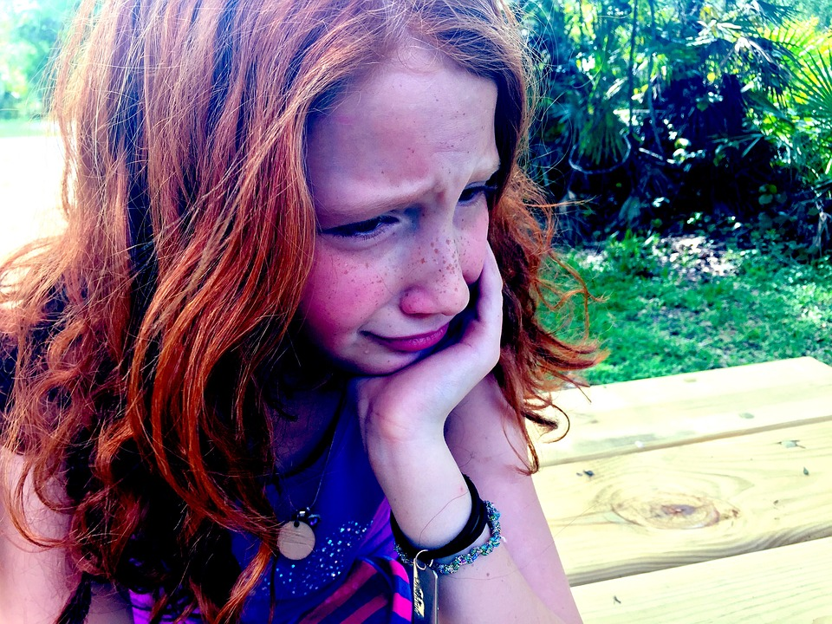
What Am I Feeling & What Should I do?
At school today, Emily told me that she didn’t want to be my friend anymore. We used to be best friends and now she hangs out with Addey. I just don’t feel like myself today.
What am I feeling?
What should I do?
https://www.youtube.com/watch?v=utZr0dPu5sk

Slide 4
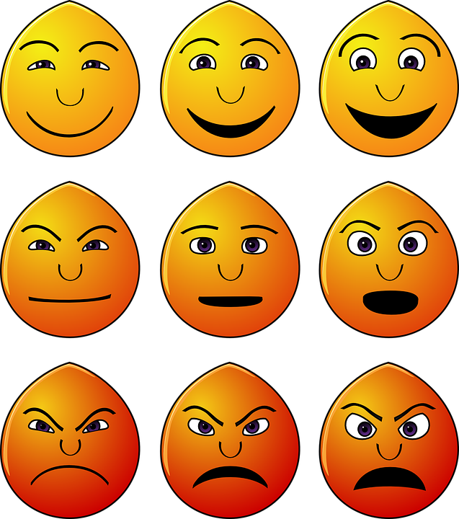
Expressing Emotions: Let’s Practice
I feel….(tell the person how you feel)
When… (tell the person why you feel that way)
I would like… (tell the person what you want to happen instead)

Slide 5
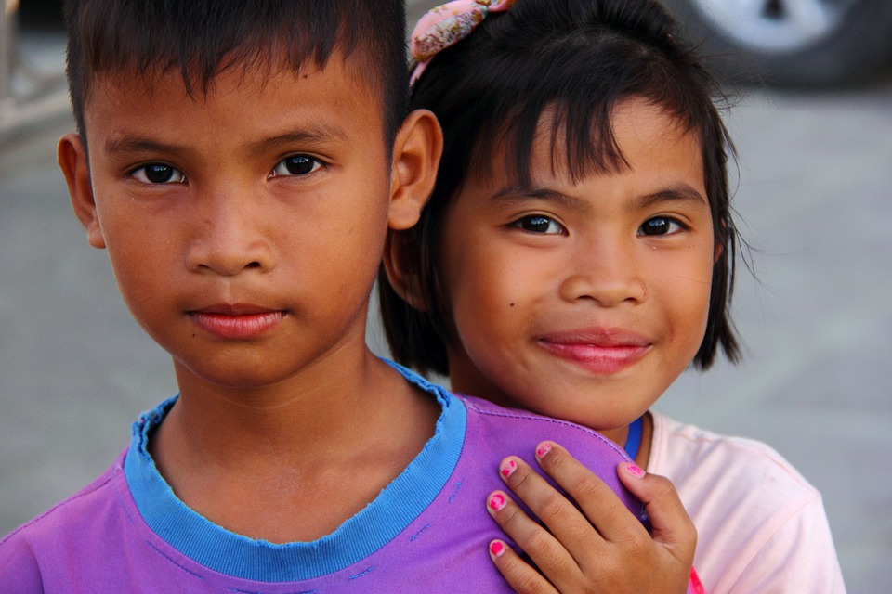
What Should I do?
I love my little sister Cynthia, but sometimes she really gets on my nerves. When she takes my stuff without asking, I feel stressed and mad. I think about pushing her but that is not right.
What should I do when I feel stressed and anger?

Slide 6
Expressing Emotions: Let’s Practice
I feel….(tell the person how you feel)
When… (tell the person why you feel that way)
I would like… (tell the person what you want to happen instead)

Slide 7
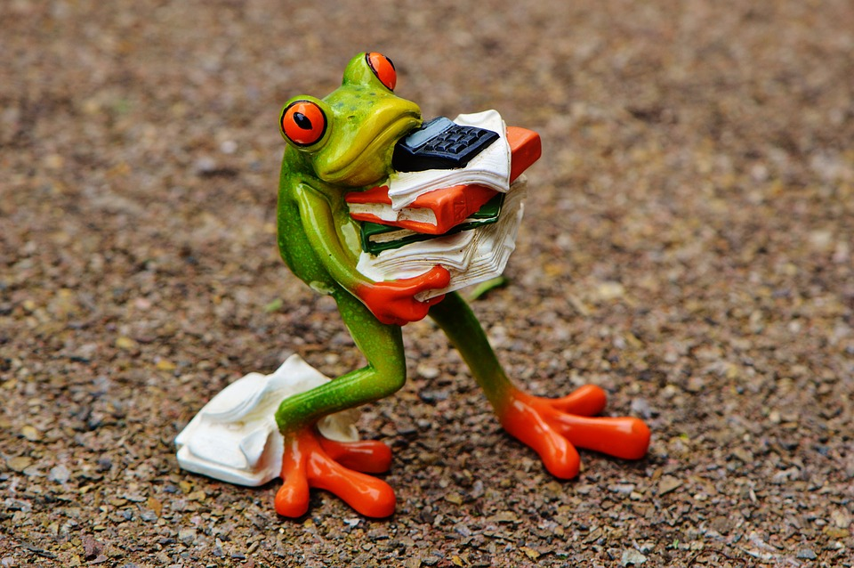
Let’s Share….
Think of a time when you felt stress. What happened? What are good ways to deal with stress?

Slide 8
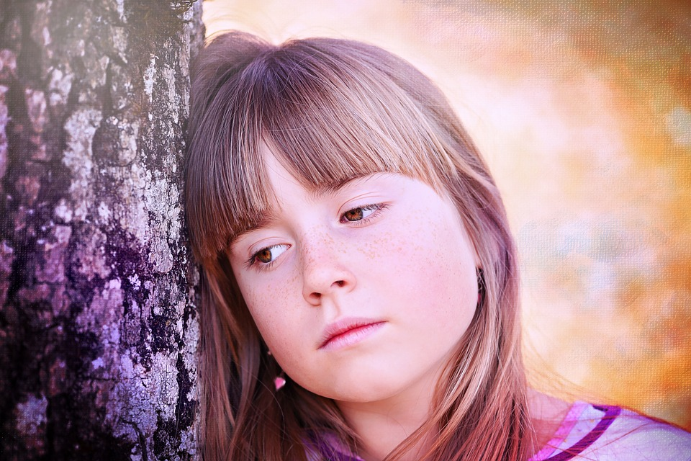
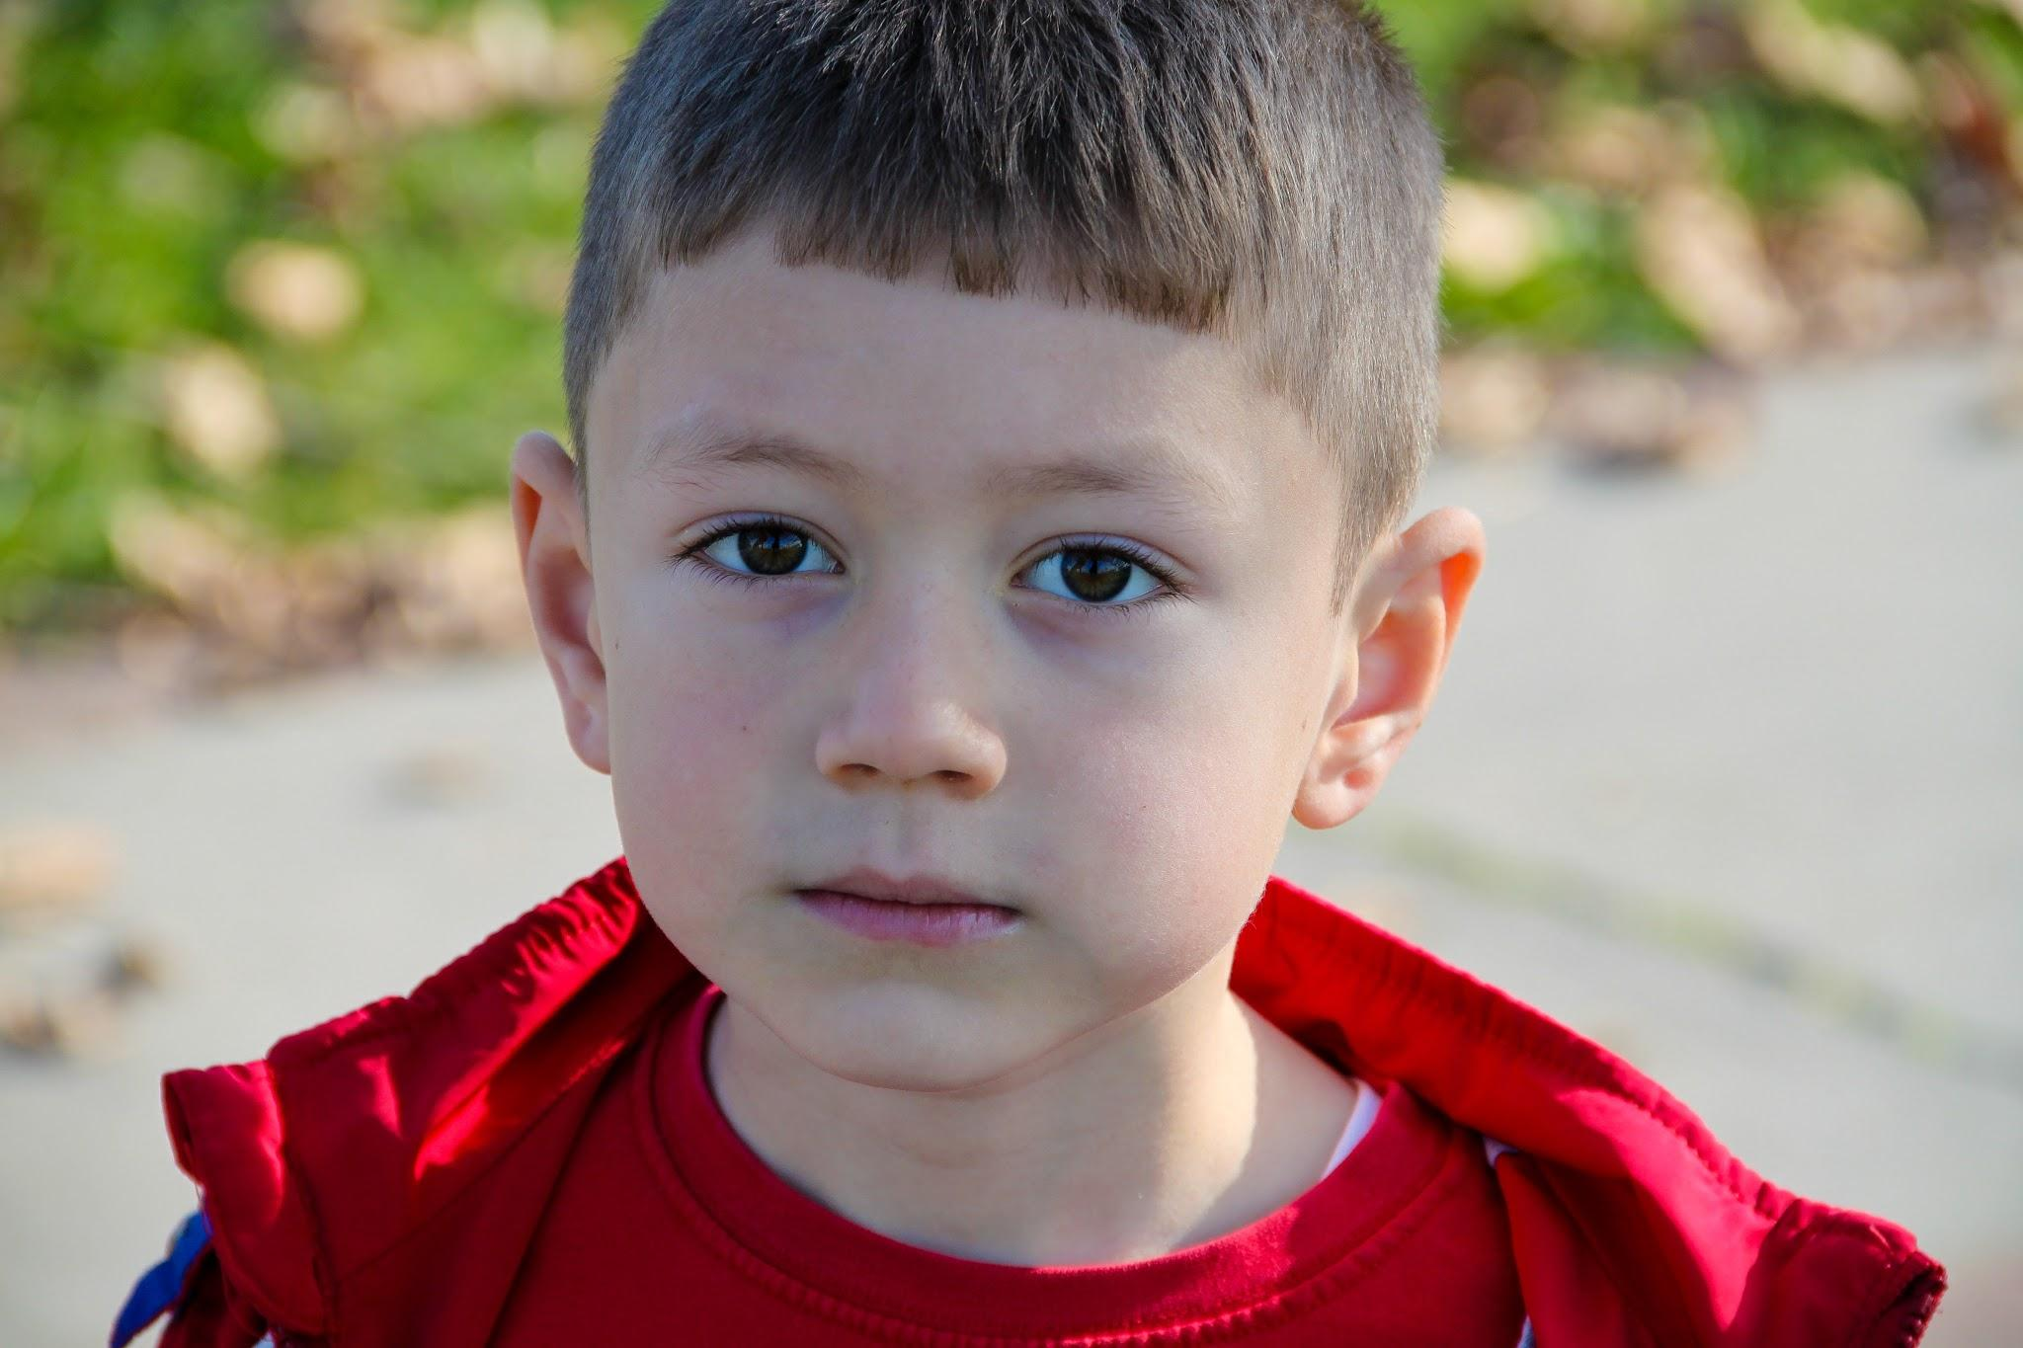
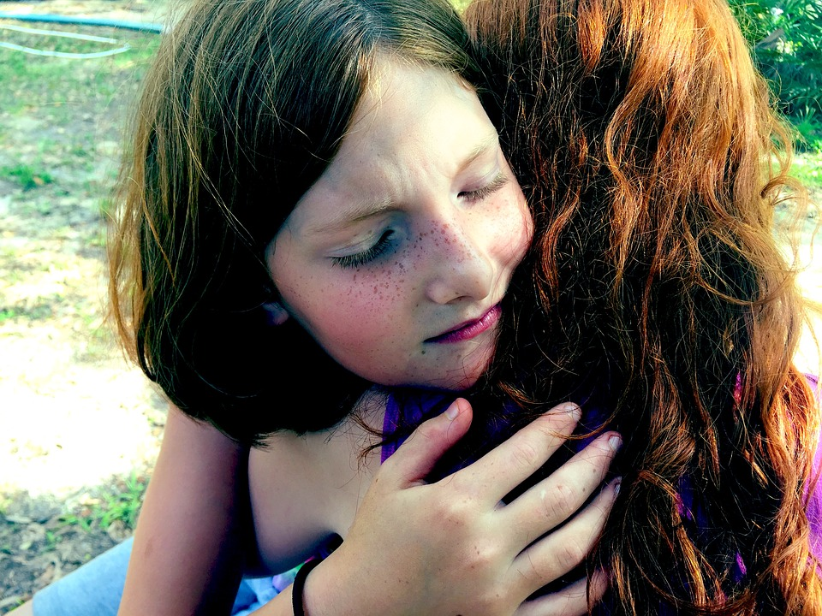
Negative Emotions: Let’s Share...
Think of all the negative emotions that you feel throughout the day or week. What other negative emotions do you feel?
What are good ways to deal with these negative emotions?

Slide 9

Dealing with Negative Emotions
Don’t Do This
Talk to a parent or trusted adult
Talk to a doctor or counselor
Exercise
Deep breathing
Do something fun
Think positive
Fighting
Yelling at someone
Hurting yourself
Hurting others
Do This

Slide 10
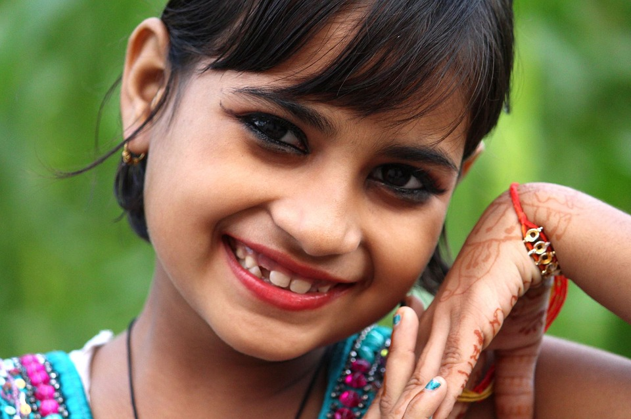
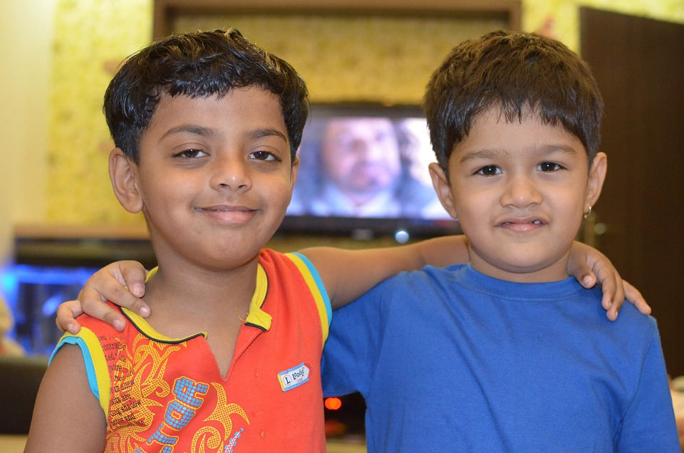
Positive Emotions: Let’s Share...
Think of all the positive emotions that you feel throughout the day or week.
What positive emotions do you feel?
What creates these positive emotions?

Slide 11
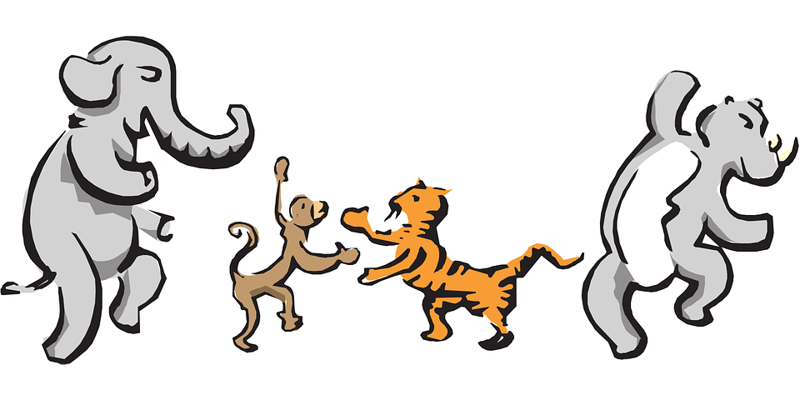
Let’s Move!
https://www.youtube.com/watch?v=KpdRc9L97TY

Slide 12
The End
Take care of yourself & Others

